Slide 1
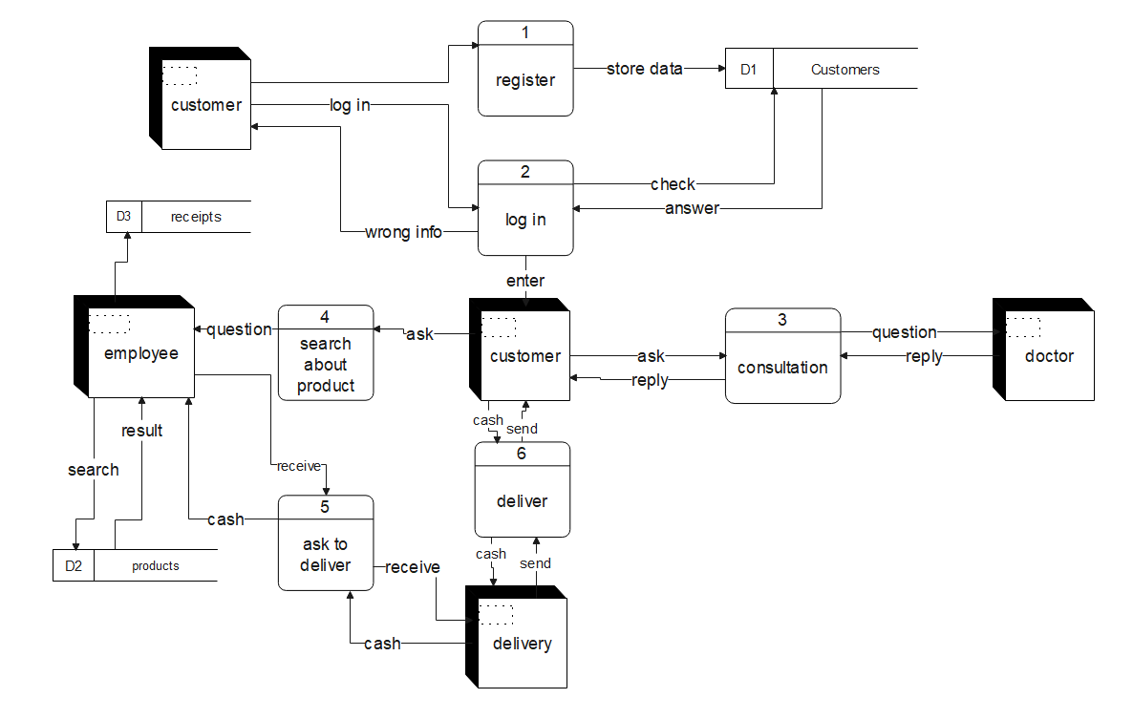
Dataflow Diagram : Level 1

Slide 2
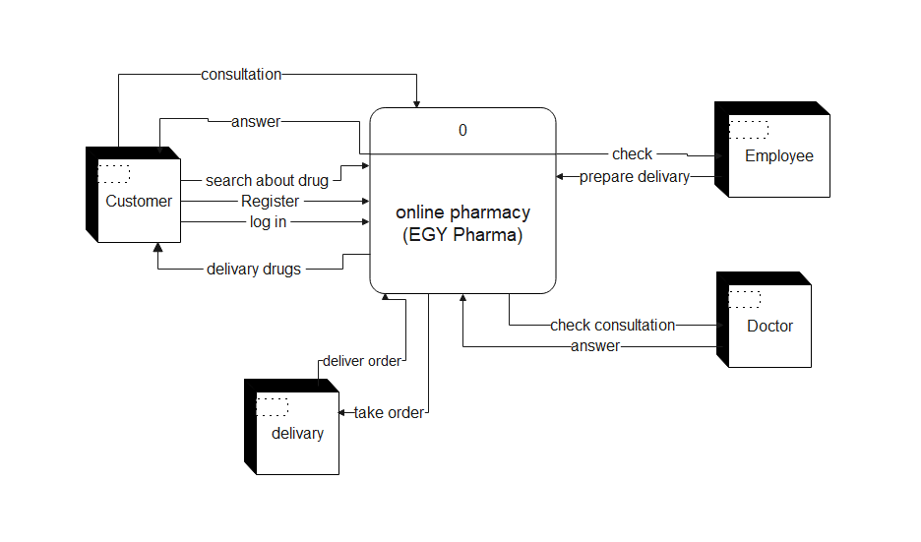
Dataflow Diagram : Context Level

